Slide 1
Ansible for Windows
The modern configuration management for Windows

Slide 2
Ansible and Windows
Agentless management
PowerShell remoting protocol
Windows native modules ~105
PowerShell Desired State Configuration (DSC) integration
Ansible just integrates smoothly with PowerShell DSC instead of developing thousands of duplicate modules

Slide 3
Common Windows modules
Install and uninstall MSIs packages
Gather facts on Windows hosts
Enable and disable Windows features and roles
Domain join
Set registry configurations
File management
Start, stop, and manage Windows Services
Create and Manage local users and groups
Manage and install Windows updates
Fetch files from remote sites
Push and execute any Powershell scripts
Full list of windows modules:
https://docs.ansible.com/ansible/2.9/modules/list_of_windows_modules.html

Slide 4
PowerShell Desired State Configuration
Windows Management Platform built in
Ships natively with Windows Server 2012 R2 and Windows 8.1 and newer
Requires PowerShell v4 or greater
External DSC resources are distributed trough PowerShell modules
Declarative configuration-based model
Similar platform to Ansible but for Windows
Define desired state of your systems
DSC determines how to execute on target
Modules overlap
Some of the ansible modules have their alternative DSC resources
It is preferred to use the ansible modules than DSC resources in such case

Slide 5
DSC Built-in vs External
Built-in:
Archive
File
Group
Package
WindowsFeature
And more..
External (Community or Vendor)
Domain Controller
IIS Web Site
SQL Server Cluster
Failover Cluster
DNS
And many more..

Slide 6
How to use DSC resource in Ansible
# PowerShell DSC Original resource definition
Configuration RegistryTest
{
Registry RegistryExample
{
Ensure = "Present"
Key = "HKEY_LOCAL_MACHINE\SOFTWARE\ExampleKey1"
ValueName = "TestValue"
ValueData = "TestData"
}
}
# PowerShell DSC Ansible resource definition
- name: Set registry key
win_dsc:
resource_name: Registry
Ensure: Present
Key: HKEY_LOCAL_MACHINE\SOFTWARE\ExampleKey1
ValueName: TestValue
ValueData: TestData

Slide 7
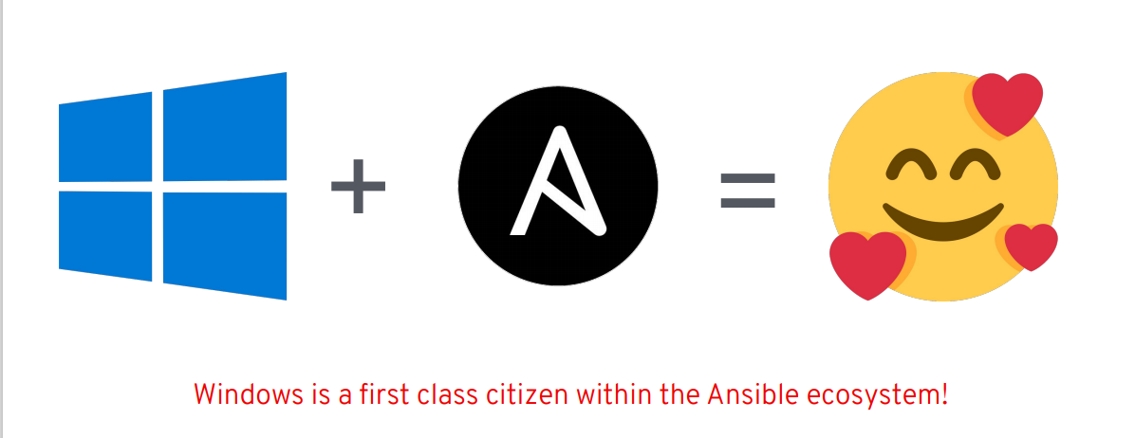
Summary

